Slide 1
Wind Energy Conversion Systems Assignment 3 Dynamic performance of Standalone PMSG
M.Shamaas
2018-MS-EE-4

Slide 2
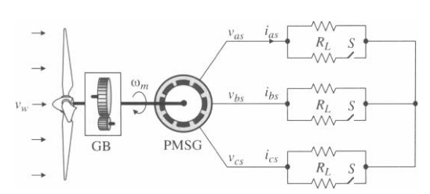
Dynamic performance of Standalone PMSG
The non-salient pole PMSG is loaded with a three-phase balanced resistive load R and operates at 320 rpm (0.8 pu) at a given wind speed. The loading of the generator is changed by switch S. When S is closed, the load resistance is reduced to R/2 per phase.

Slide 3
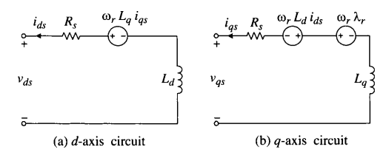
PMSG d- and q- axis Circuits

Slide 4
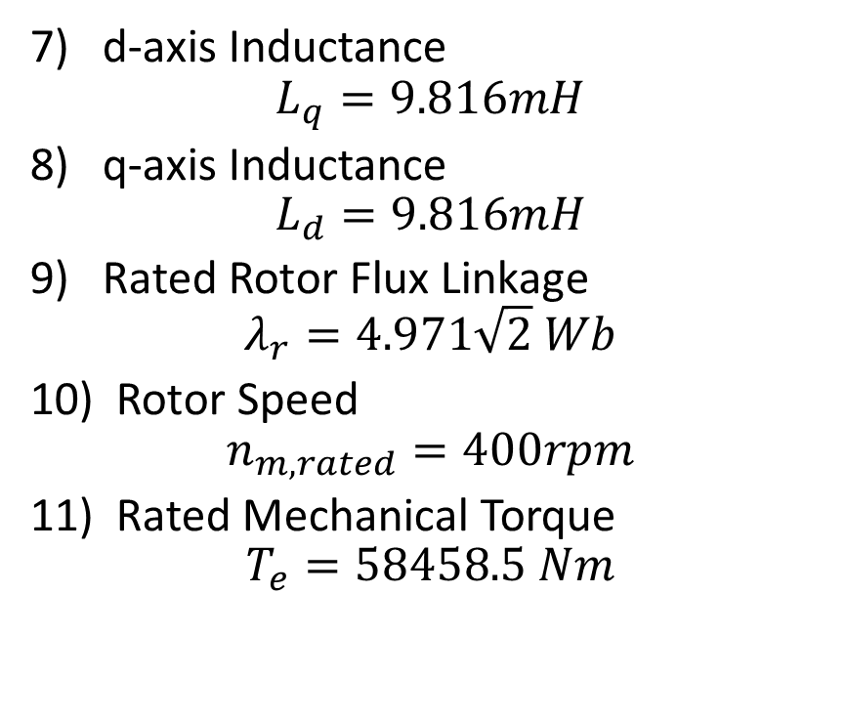
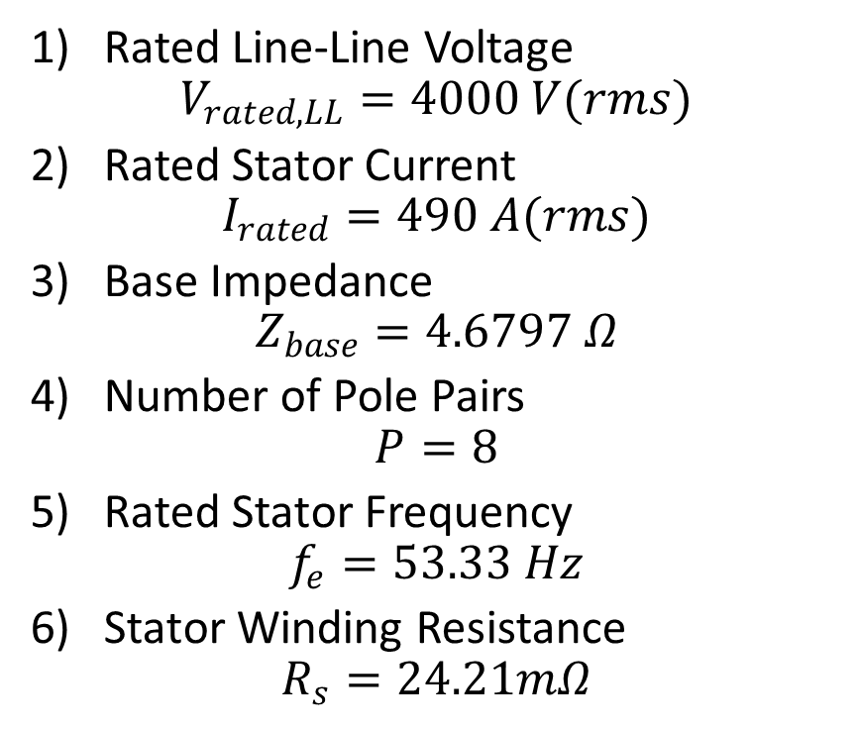
PMSG Machine Constants
1) Rated Line-Line Voltage
$$V_{rated,LL}=4000 V(rms)$$
2) Rated Stator Current
$$I_{rated}=490 A(rms)$$
3) Base Impedance
$$Z_{base}=4.6797 Ω$$
4) Number of Pole Pairs
$$P=8$$
5) Rated Stator Frequency
$$f_{e}=53.33 Hz$$
6) Stator Winding Resistance
$$R_{s}=24.21mΩ$$
7) d-axis Inductance
$$L_{q}=9.816mH$$
8) q-axis Inductance
$$L_{d}=9.816mH$$
9) Rated Rotor Flux Linkage
$$λ_{r}=4.971\sqrt{2} Wb$$
10) Rotor Speed
$$n_{m,rated}=400rpm$$
11) Rated Mechanical Torque
$$T_{e}=58458.5 Nm$$

Slide 5
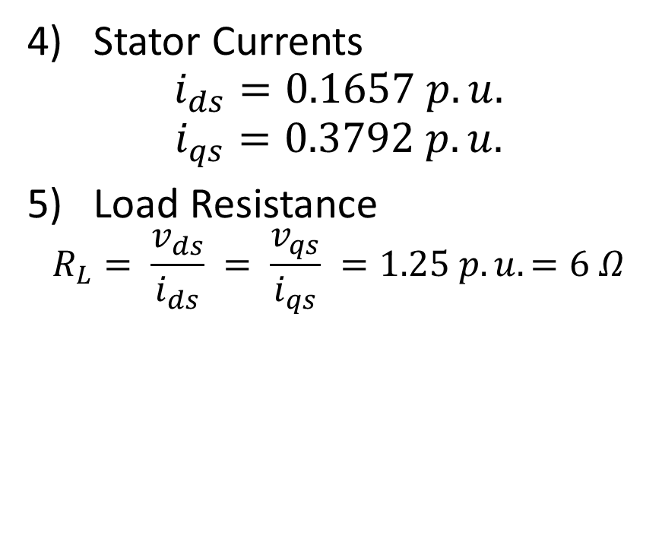
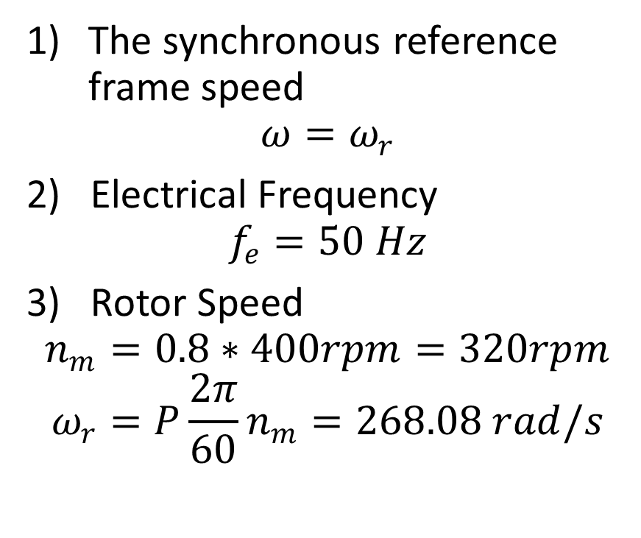
Initial Conditions (t = 0-)
The synchronous reference frame speed
$$ω=ω_{r}$$
2) Electrical Frequency
$$f_{e}=50 Hz$$
3) Rotor Speed
$$n_{m}=0.8∗400rpm=320rpm$$
$$ω_{r}=P\frac{2π}{60}n_{m}=268.08 rad/s$$
4) Stator Currents
$$i_{ds}=0.1657 p.u.$$
$$i_{qs}=0.3792 p.u.$$
5) Load Resistance
$$R_{L}= \frac{v_{ds}}{i_{ds}} = \frac{v_{qs}}{i_{qs}} =1.25 p.u.=6 Ω$$

Slide 6
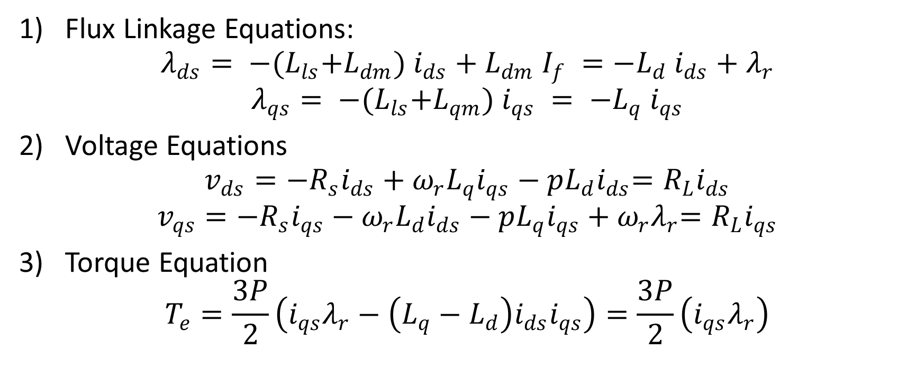
PMSG d- and q- axis Equations
1) Flux Linkage Equations:
$$λ_{ds}= −{{(L}_{ls}+L_{dm}) i}_{ds}+{L_{dm} I}_{f} =−{L_{d} i}_{ds}{ + λ}_{r}$$
$$λ_{qs}= −{{(L}_{ls}+L_{qm}) i}_{qs} = −{L_{q} i}_{qs}$$
2) Voltage Equations
$$v_{ds}={−R_{s}i}_{ds} {+ ω_{r}L_{q}i}_{qs}{ − pL_{d}i}_{ds}={R_{L}i}_{ds}$$
$$v_{qs}={−R_{s}i}_{qs} {− ω_{r}L_{d}i}_{ds}{ − pL_{q}i}_{qs}{ + ω_{r}λ}_{r}=R_{L}i_{qs}$$
3) Torque Equation
$$T_{e}=\frac{3P}{2}\left(i_{qs}λ_{r}−\left(L_{q}−L_{d}\right)i_{ds}i_{qs}\right)=\frac{3P}{2}\left(i_{qs}λ_{r}\right)$$

Slide 7
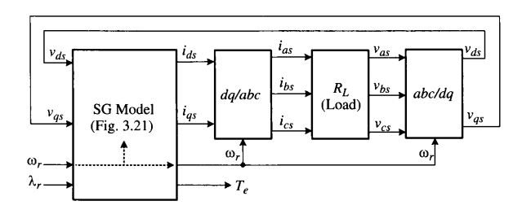
System Block Diagram

Slide 8
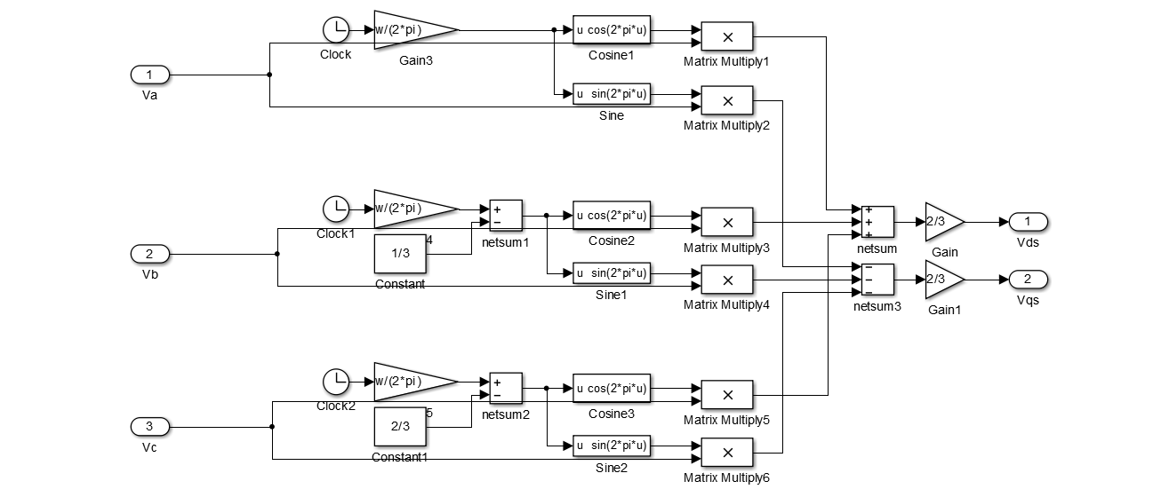
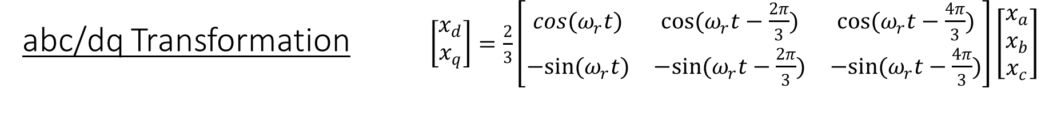
abc/dq Transformation $\left[\begin{matrix}x_{d} \\ x_{q}\end{matrix}\right]=\frac{2}{3}\left[\begin{matrix}cos{(ω}_{r}t) & cos(ω_{r}t−\frac{2π}{3}) & cos(ω_{r}t−\frac{4π}{3}) \\ −sin(ω_{r}t) & −sin(ω_{r}t−\frac{2π}{3}) & −sin(ω_{r}t−\frac{4π}{3})\end{matrix}\right]\left[\begin{matrix}x_{a} \\ x_{b} \\ x_{c}\end{matrix}\right]$

Slide 9
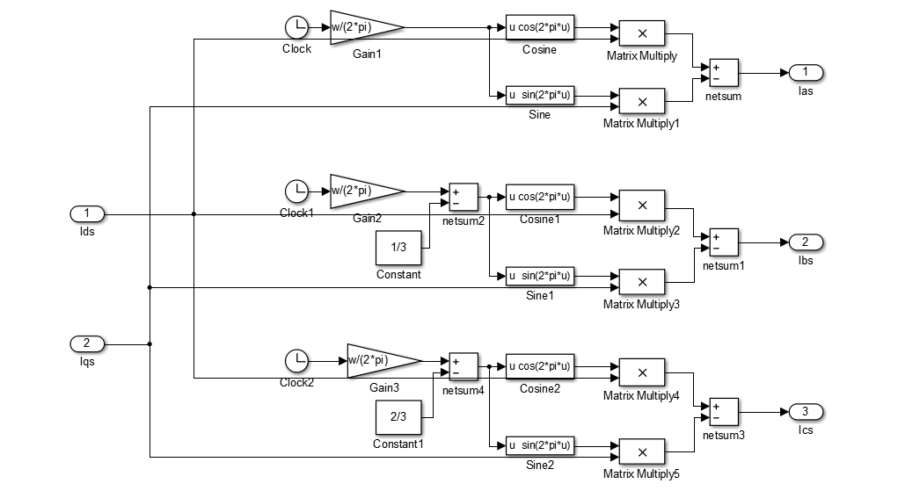
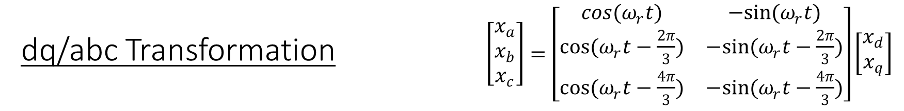
dq/abc Transformation $\left[\begin{matrix}x_{a} \\ x_{b} \\ x_{c}\end{matrix}\right]=\left[\begin{matrix}cos{(ω}_{r}t) & −sin(ω_{r}t) \\ cos(ω_{r}t−\frac{2π}{3}) & −sin(ω_{r}t−\frac{2π}{3}) \\ cos(ω_{r}t−\frac{4π}{3}) & −sin(ω_{r}t−\frac{4π}{3})\end{matrix}\right]\left[\begin{matrix}x_{d} \\ x_{q}\end{matrix}\right]$

Slide 10
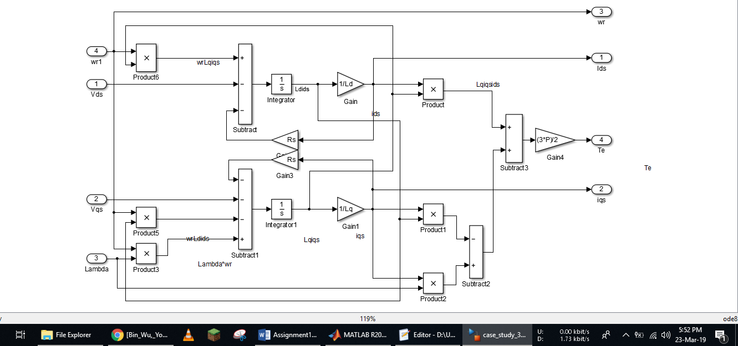
PMSG System

Slide 11
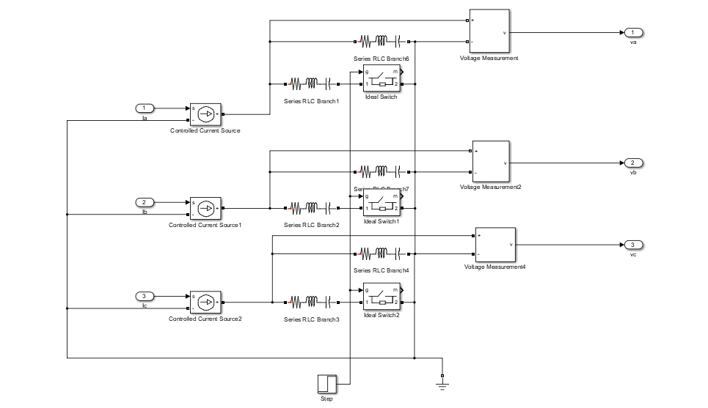
Resistive Load and Ideal Switches

Slide 12
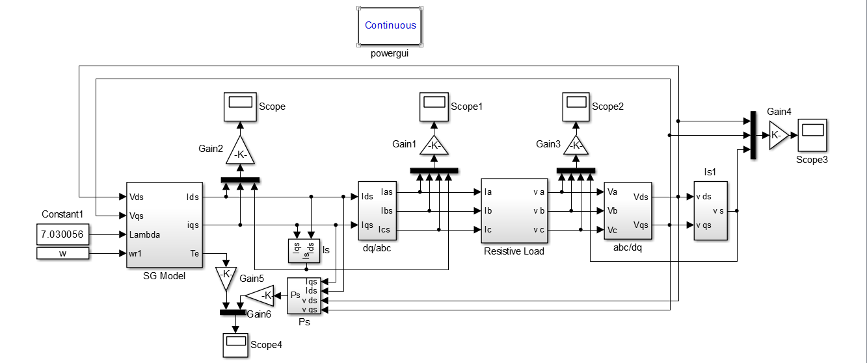
Block diagram for dynamic simulation of standalone PMSG.

Slide 13
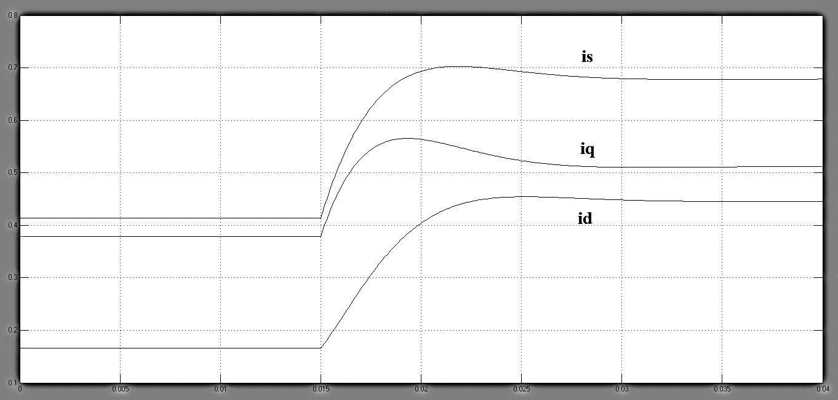
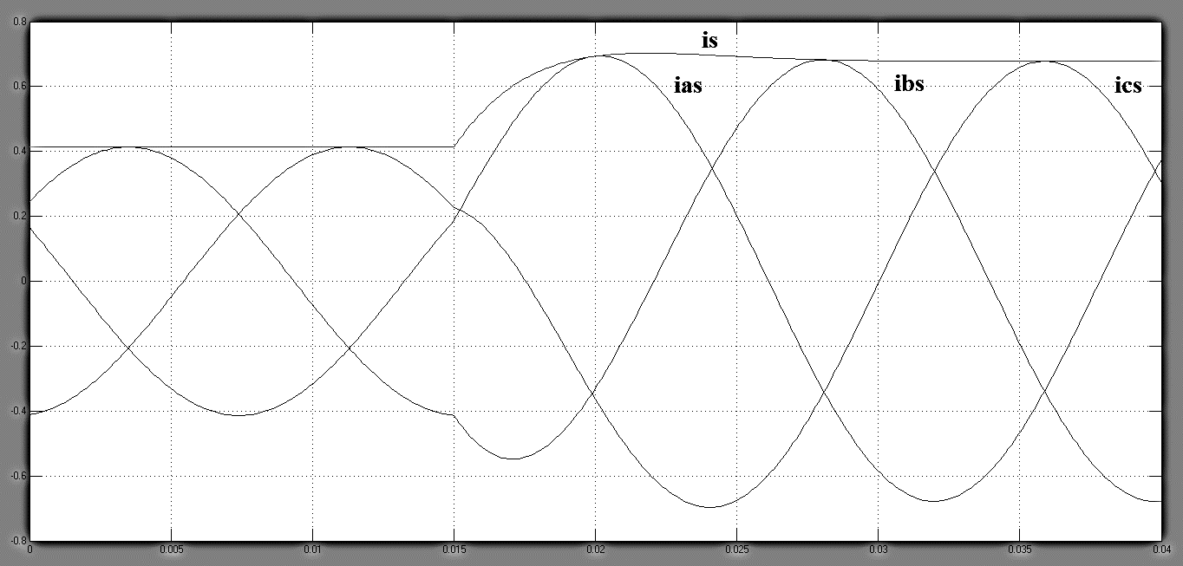
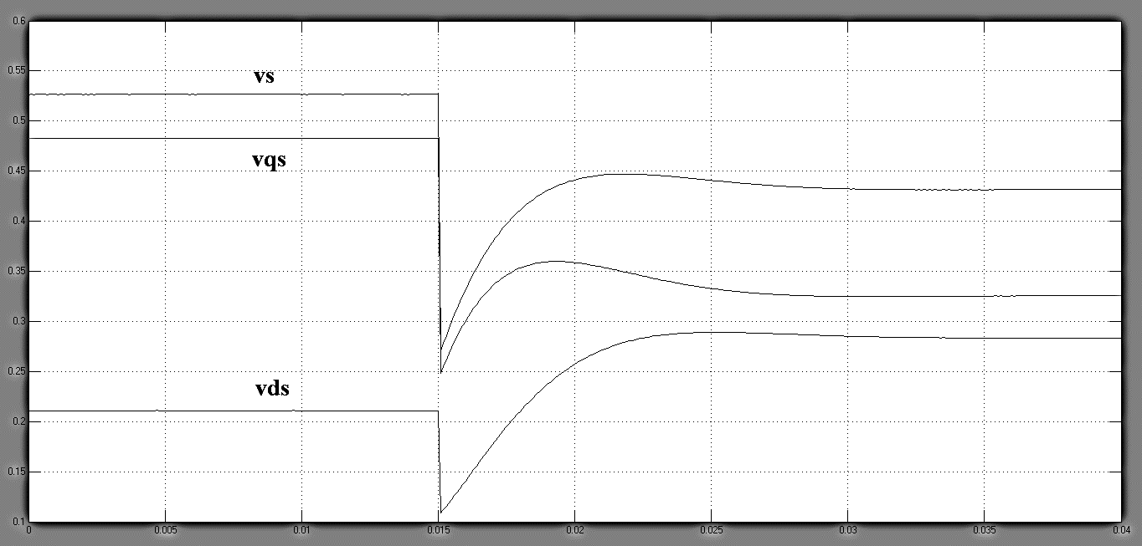
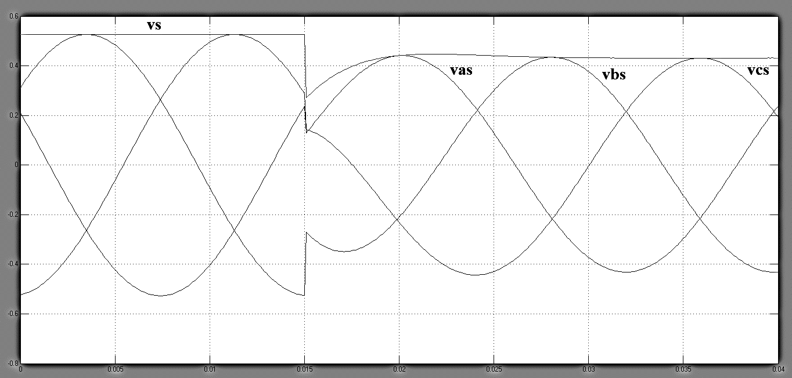
dq variables abc variables

Slide 14
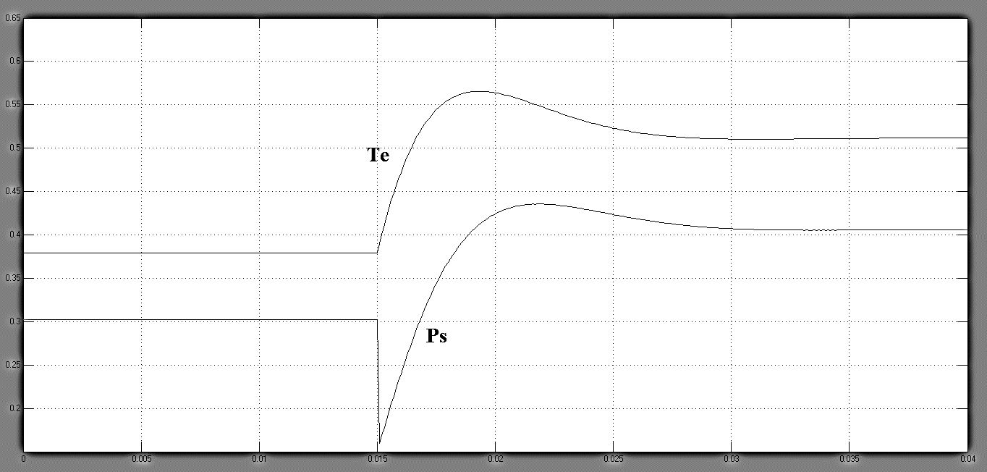
Torque and Power

Slide 15
Conclusion
The generator initially operates in steady state with a resistive load of R.
The load resistance is reduced to R/2 by closing switches at t = 0.015 sec. After a short transient period, the system reaches a new steady-state operating point.
The dq-axis stator currents, ids and iqs, in the synchronous frame are DC variables, whereas the abc-axis stator currents, ias, ibs, and ics, in the stationary frame are sinusoids in steady state. The magnitude of the stator current represents the peak value of ias, ibs and ics. A similar phenomenon can be observed for the stator voltages.
A decrease in the load resistance results in an increase in the stator currents (is increases from 0.4139 p.u. to 0.6738 p.u.), but the stator voltages are reduced (vs reduces from 0.5266 p.u. to 0.4316 p.u.) mainly due to the voltage drop across the stator inductances.
The electromagnetic torque Te and stator active power Ps are increased (Te increases from 0.3792 p.u. to 0.5118 p.u., Ps increases from 0.3021 p.u. to 0.4061 p.u.) accordingly when the system operates at the new operating point.

